Slide 1
Introduction to Syngenta
October 2015

Slide 2
Syngenta
Based in Basel
Biggest pesticide company in the world
  Very similar business to pharmaceuticals
    Chemicals with intended biological effects
    Huge R&D costs, long time to market
    Highly regulated
Third biggest crop breeding company in the world
  Mostly conventional breeding
  Some GM crops
Being bought by ChemChina for $42 billion

Slide 3
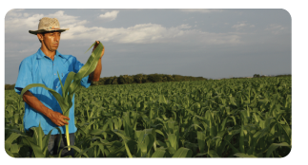
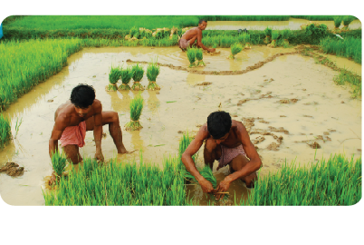
Helping small and large farms meet the challenges of global food security
8M
Our ambition
is to bring greater food security in an environmentally sustainable way
to an increasingly populous world
by creating a worldwide step-change
in farm productivity
large-scale farms
>100 Ha
450M
smallholder farms
~2.0 Ha
Notes:
Notes:
To achieve global food security we must recognize the imperative of yield gain but also go beyond it, to encompass all the resources involved.
Our ambition is to bring greater food security in an environmentally sustainable way.
That calls for a step-change in productivity and resource efficiency – on both the world’s eight million large farms and its 450 million smallholdings.
Every farmer has a part to play.

Slide 4







The Good Growth Plan
We’ve made six commitments to help grow more food using fewer resources, while protecting nature, and at the same time helping people in rural communities live better lives
More food
Less waste
More biodiversity
Less degradation
More health
Less poverty
Make crops
more efficient
Rescue more farmland
Help biodiversity flourish
Empower smallholders
Help people stay safe
Look after every worker
Increase average productivity of the world’s major crops by 20% without using more land, water or inputs
Improve the fertility of 10 million hectares of farmland on the brink of degradation
Enhance biodiversity on 5 million hectares of farmland
Reach 20 million smallholders and enable them to increase productivity
by 50%
Train 20 million farm workers on labor safety, especially in developing countries
Strive for fair labor conditions throughout our entire supply chain network
One planet. Six commitments.
Notes:
Notes:
Our planet is facing the challenge of feeding 9 billion by 2050, and our resources are ever more stretched. So Syngenta has made six commitments to help grow more food using fewer resources, while protecting nature, and at the same time helping people in rural communities live better lives.
We call this The Good Growth Plan.
Make crops more efficient. Syngenta will increase the average productivity of the world’s major crops by 20 percent without using more land, water or inputs. That means that we will grow more food without increasing the land area under cultivation. Yield will increase. The volume of water and pesticides used will not.
Rescue more farmland and help biodiversity flourish. Syngenta will improve the fertility of 10 million hectares of farmland currently on the brink of degradation through practices such as minimum tillage and crop rotation. And we will enhance the biodiversity on five million hectares of farmland with the introduction of buffer strips and species protection programs.
Improve health and reduce poverty among smallholder farmers, and improve worker safety. Over the next seven years Syngenta aims to reach 20 million smallholders and to enable them to increase productivity by 50 percent. Syngenta will train 20 million farm workers, especially in developing countries, on labor safety. And Syngenta aims to look after every worker by striving for fair labor conditions throughout our entire supply chain network.

Slide 5
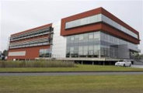






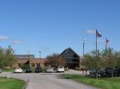
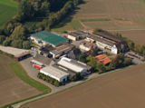



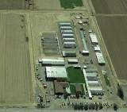

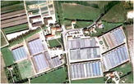
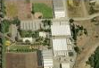

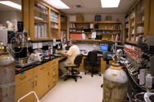

Key R&D centers across the world
Unrivalled global breadth
Over 150 R&D sites around the world
supported by many field locations
Ghent
Belgium
Jealott’s Hill
UK
Landskrona
Sweden
Clinton
US
Stanton
US
Enkhuizen
Netherlands
Greensboro
US
Bad Salzuflen
Germany
Slater
US
Research Triangle Park, US
Stein
Switzerland
Beijing
China
Woodland
US
Saint Sauveur
France
Sarrians
France
Gilroy
US
Goa
India
Alachua
US
Uberlândia
Brazil
Notes:
5

Slide 6
Global scientific & engineering functions
Research & Development
(R&D)
Manufacturing & Supply
Technology & Engineering (T&E)
Research & Development
Information Systems (R&DIS)

Slide 7

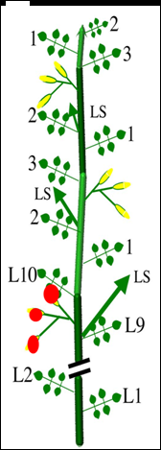
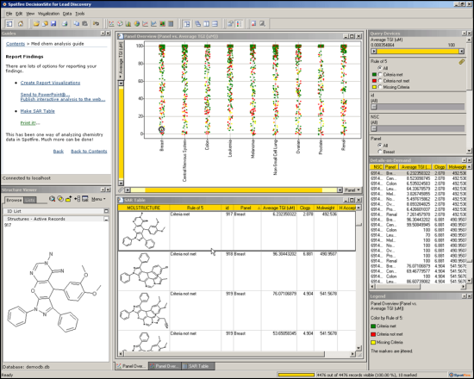
Insight
Linking together the scattered
Syngenta modelling community
Biology
Environment
Chemistry
Foresight
Sharing skills and experience
Help build Syngenta capability
Identifying cross-business
modelling opportunities

Slide 8
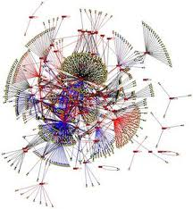
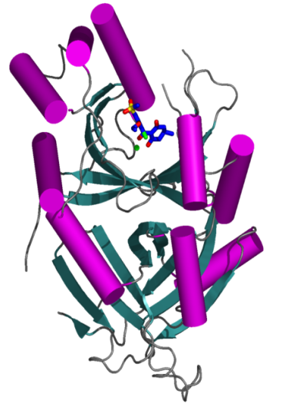
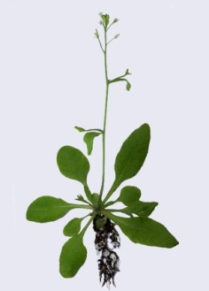
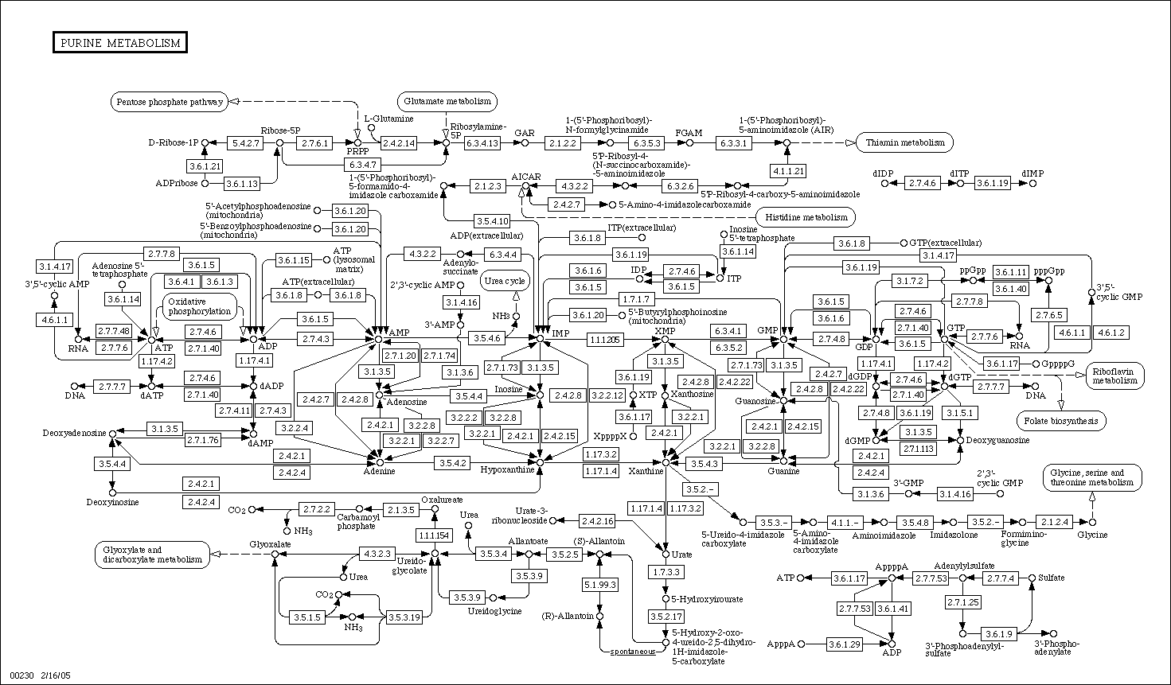
The Syngenta challenge – integration, scale-up, taming complexity
n

Slide 9
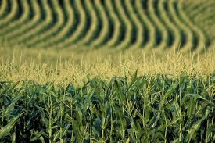
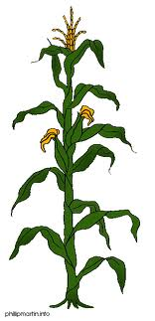
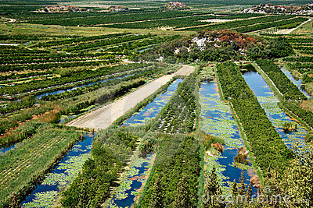
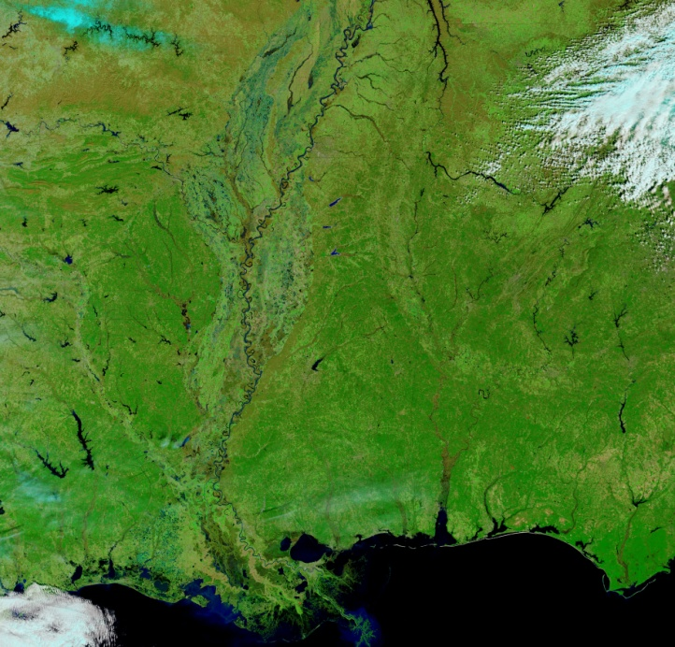
The Syngenta challenge – integration, scale-up, taming complexity
Disease
Pests
Human and
environmental
protection
Drought
Weeds
Nutrients
Pesticides

Slide 10
Degradation of chemicals in soil
Regulatory study
  Several timepoints
  Replication
  High measurement precision
  Results determine regulatory acceptability
Screening study
  Same soil, but different…
  Different conditions (for simplicity, to reduce test substance needed, to reduce cost)
  Fewer timepoints
  Less precision

Slide 11
Ranking new chemicals based on heterogeneous data
Different herbicide screens: A, B, C
  Differ in scale, amount of test chemical required, duration
  Species tested, eg tropical grasses vs temperate grasses, or broadleaved vs grasses
  Application timing: seed i.e. pre-emergence vs seedling i.e. post-emergence
Each screen incudes several plants of several species
Each chemical is tested at a few application rates
Chemicals are run through screens in batches
There is run to run variation in results of a screen
The percent control of each species is scored, ie 0% = the chemical did nothing, 100% = the chemical completely killed all plants. These data are used to fit a logistic regression model and an ED50 (effective dose, 50%) number is calculated

Slide 12
Ranking new chemicals based on heterogeneous data
Results for 1 chemical in 1 screen
 | Species | A | B | C | D | E | F | G | H
Score at each application rate | 100g/ha | 10 | 0 | 0 | 0 | 20 | 0 | 0 | 0
 | 500g/ha | 20 | 40 | 30 | 0 | 80 | 10 | 20 | 0
 | 1000g/ha | 30 | 90 | 75 | 10 | 100 | 50 | 40 | 10
 | ED50 | 1500 | 600 | 750 | >1000 | 280 | 1000 | 1200 | >1000

Slide 13
Ranking new chemicals based on heterogeneous data

Slide 14
Ranking new chemicals based on heterogeneous data
Traditional approach
  Pairwise comparisons with “best”
  If better than the “best” then you have a new winner
But now we want to rank all chemicals tested
  To spot trends
  To better understand chemical space
  To direct chemistry towards better areas

Slide 15
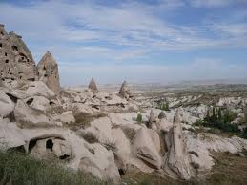
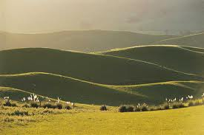
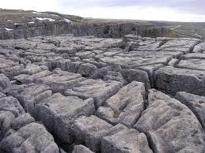
But sometimes parts of
chemical space look like this
Normally models assume that
chemical space looks like this
or this

Slide 16
Formulation toxicity
We know the toxicity of all the formulations
We can assume additive toxicity for formulation ingredients
We know the toxicity of some ingredients tested singly
How can be back out toxicity estimates for as many ingredients as possible?
How can we spot non-additive effects?

Slide 17
Scheduling seed production
You need to grow varieties in 2017 to harvest seed you can sell for farmers to grow in 2018, so you need to plan what to do now!
You have 50 varieties you need to produce, each with a production target, some more profitable than others
You have 17 growing areas in which you can grow your varieties
Each growing area has a limited number of fields available to you
Each year some growing areas have higher average yields and some lower
Yield is very uncertain, especially at the individual field level
Average yield and variability of yield differ for each variety
There is a chance of losing all yield for any individual field, and also for a whole growing area
If you overproduce you lose money, if you underproduce you lose money
The most important factor is spatial variation in yield in 2017, which you cannot know, but we do now the pattern for the last 30 years
(The newspaper seller problem is relevant)

